Slide 1


BEST STATE-OF-THE-ART MODELS FOR SEMANTIC SEGMENTATION PROBLEMS AND THEIR ABILITIES AND LIMITATIONS
Author: Angelika Żyła
19.06.2024

Slide 2


Project goal
The primary objective of this project is to leverage the Breast Ultrasound Dataset to develop a robust and accurate machine learning model for the early detection and diagnosis of breast cancer.

Slide 3
Dataset
The dataset contains medical images of 600 female patients aged 25 to 75 years, collected in 2018. It contains a total of 780 images, each with an average resolution of 500 x 500 pixels, and all images are provided in PNG format. The images are divided into three distinct classes: normal, benign and malignant, reflecting the different conditions that can be observed in breast tissue.

Slide 4
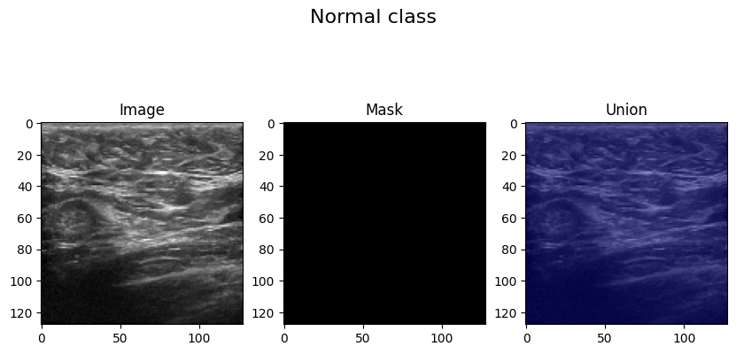

Dataset
Fig 1. Normal class

Slide 5
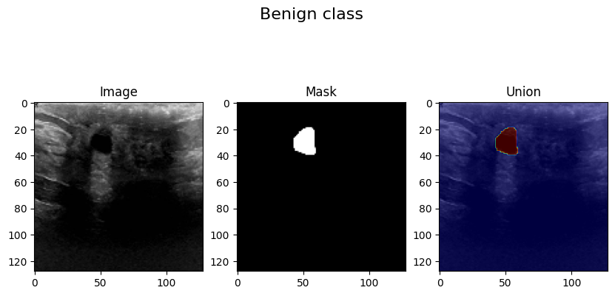
Dataset
Fig 2. Benign class

Slide 6
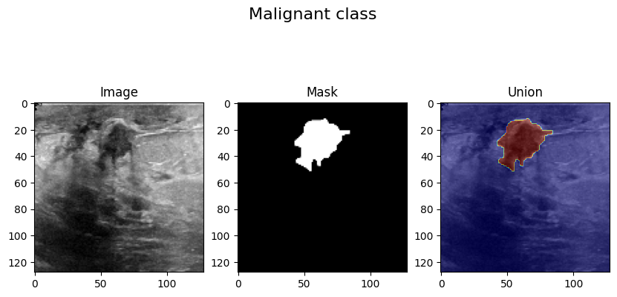
Dataset
Fig 3. Malignant class.

Slide 7
Dataset
'Normal' class has 133 images and 133 masks.
'Benign' class has 437 images and 454 masks.
'Malignant' class has 210 images and 211 masks.
There are total of 780 images and 798 masks.

Slide 8



Models
U-Net
FCN
SegNet
PSPNet

Slide 9
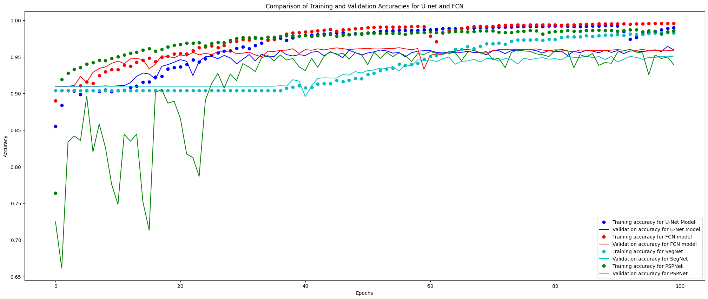
Results
Fig 4. Accuracy comparision

Slide 10
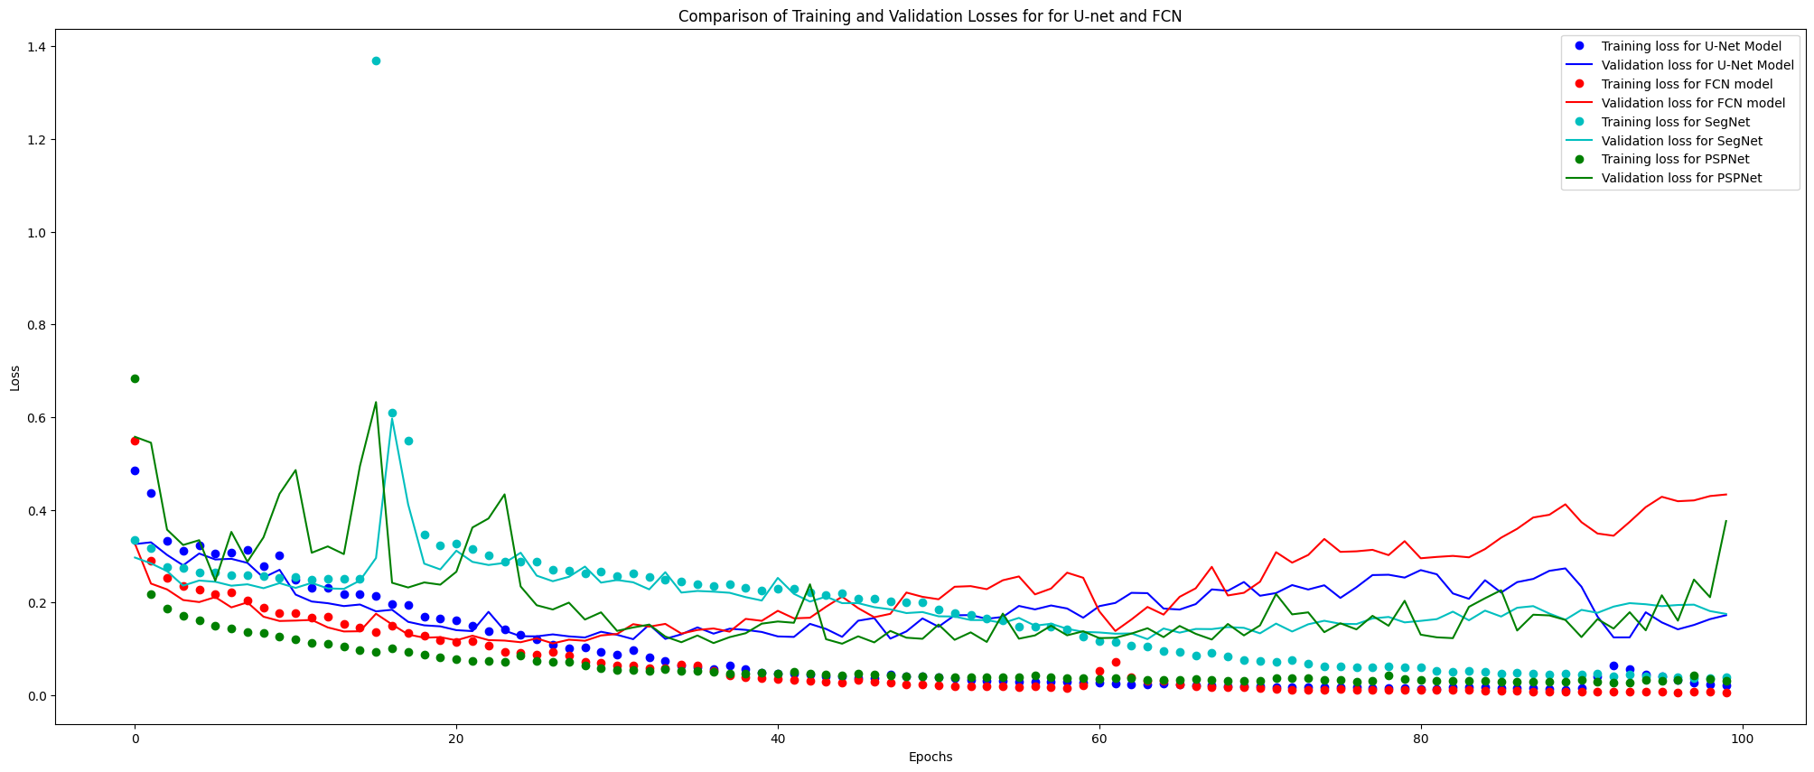
Results
Fig 5. Loss comparision

Slide 11
Added layers for encoding (downsampling) and decoding (upsampling
Added connections using the "concatenate" option to connect feature maps from encoder to decoder
FCN
Filters added - Each layer has many filters, and the network gradually increases the number of filters
Bottleneck layer representing dense objects

Slide 12
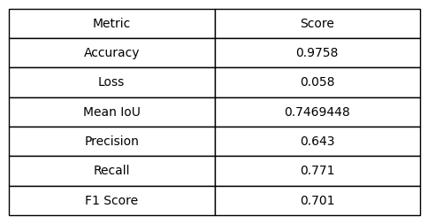
Results
Fig 6. Best results, FCN model metrics

Slide 13
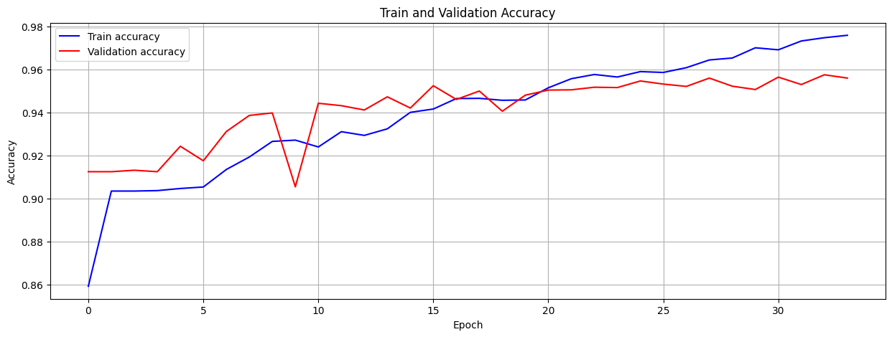
Results
Fig 7. Train and Validation Accuracy

Slide 14
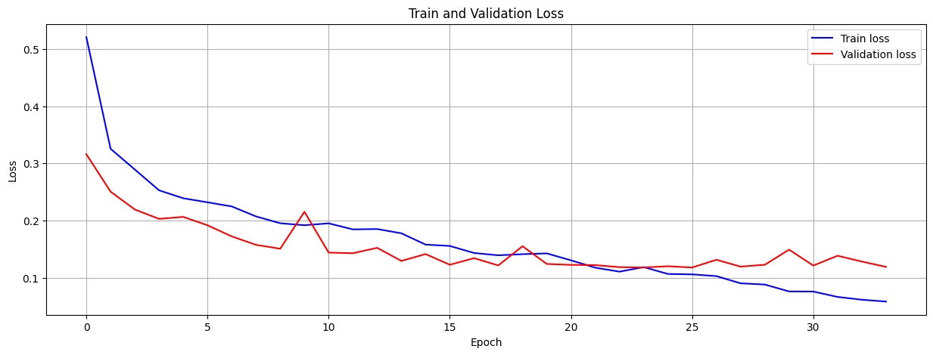
Results
Fig 7. Train and Validation Loss

Slide 15
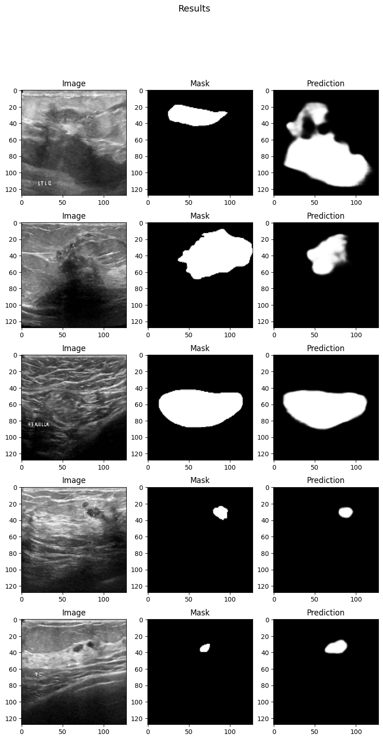
Results
Predictions cover similar areas as ground truth masks but are somewhat blurry and less precise, with blurred edges.
Instances of false positives occur, with predictions extending beyond the actual lesions, indicating over-prediction.
Predictions generally align well with ground truth masks in shape and size, showing overall accuracy in identifying regions of interest.
The model consistently predicts slightly larger regions than actual lesions, suggesting overestimation of abnormal tissue extent.

Slide 16
Summary
The FCN model employs a sophisticated architecture with an encoder for downsampling, a dense bottleneck layer, and a decoder for upsampling. Skip connections are utilized to retain spatial information across layers, enhancing segmentation accuracy.
The model demonstrated high accuracy and low loss on training data, indicating effective learning.
While validation accuracy and loss showed some fluctuations, indicating potential overfitting, the use of regularization and early stopping successfully alleviated this issue.
Training losses consistently decreased, whereas validation losses exhibited some variability, underscoring the ongoing challenge of ensuring the model's generalization to unseen data.

Slide 17
Thank you for your attention!

